Slide 1
Student Managed Investment Funds
International Investing

Slide 2
What is International Investing?
Global Perspective:
Equity
Bonds
Currency
International or Global
Developed or Emerging

Slide 3
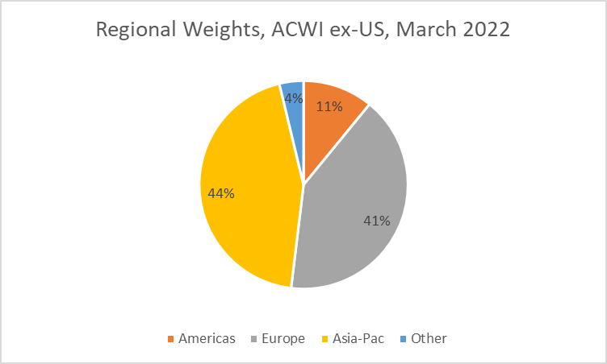
Global Equity Overview
US is the largest equity market by capitalization (over 60%)
Europe and Asia-Pacific are the largest regions outside the US

Slide 4
Sector Differences between US and International

Slide 5
Currency Issues
Exposure to currency fluctuations
Trade and settlement: local or dollars
Hedging: why, whether and how
Currency as an investment

Slide 6
Currency Impact
Currency moves may have a big impact in the short term
Over decades, the impact is more modest

Slide 7
ADRs Provide a Practical Approach
For SMIFs the most practical approach to accessing non-US equities, including handling currency issues, may be investing through American Depositary Receipts (ADRs)
 | Europe | Asia Developed | Asia EM | Other EM
Primary listing on a US exchange | 55 | 6 | 5 | 7
Secondary listing on a US exchange | 94 | 26 | 11 | 5
ADR on US exchange | 125 | 29 | 201 | 113
ADR OTC | 811 | 684 | 284 | 211

Slide 8
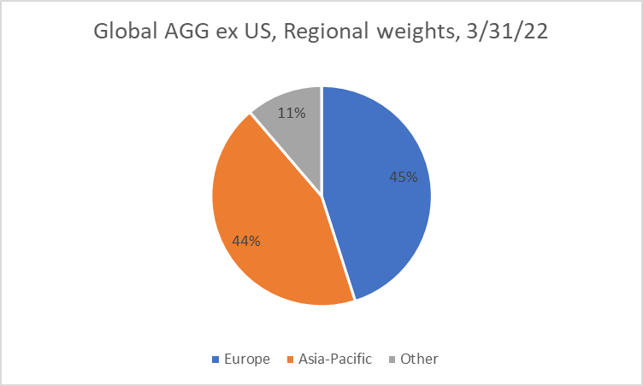
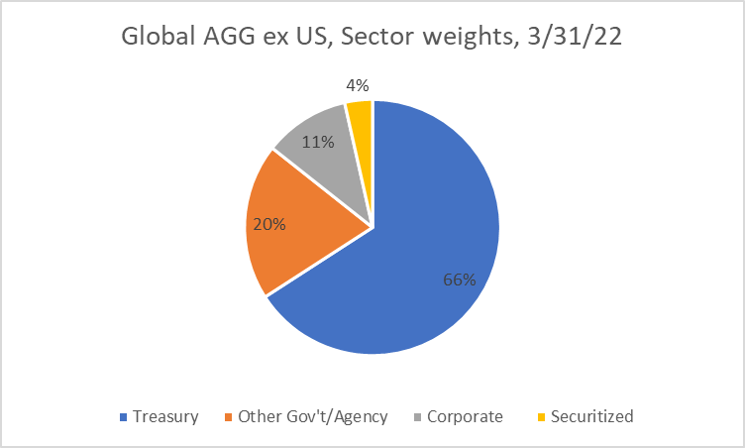
Global Bond Overview
Global bond markets are dominated by government issuers
US is the largest market (close to 40% of the total capitalization)
Europe and Asia-Pacific are the largest regions outside the US

Slide 9
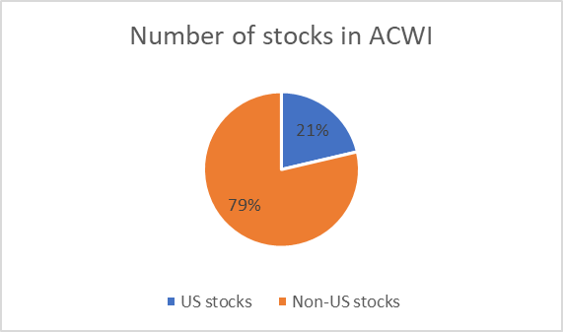
Why International? Opportunity
Broaden the opportunity set
More than ¾ of world stocks are outside the US

Slide 10
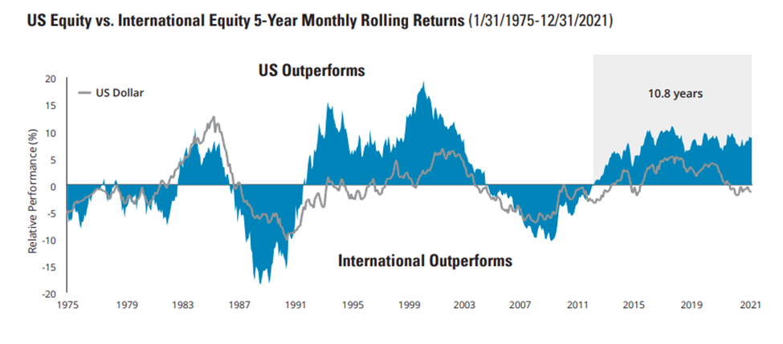
Why International? Diversify
US and International Markets Do Not Move “in sync”
The chart shows the values of the S&P 500 Index’s return minus the MSCI World ex USA Index’s return. When the line is above 0, US stocks outperformed international stocks. When the line is below 0, international stocks outperformed US stocks.
Source: Hartford Funds (including input from Morningstar and Bloomberg). US equity is represented by the S&P 500 Index, International equity is represented by MSCI World ex-US Index. Permission for educational use only granted by Hartford Funds.

Slide 11
Timeline of International Investing from US
1974: Repeal of IET (Interest Equalization Tax) and passing of ERISA
Steady growth of international equity mandates through 1980s, but still considered “alternative”
By the 1990s, global and EM equity, global and international bonds were becoming more common
Enthusiasm for international/global equity peaked in the mid-2000s, as there followed an extended period of US outperformance
Looking forward (2020s): will investors adopt a global mindset, or still look at international investing as an opportunistic “add-on” to a domestic portfolio?

Slide 12
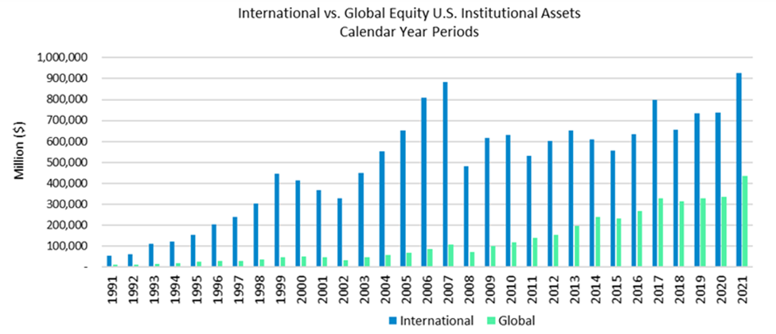
Popularity of Global vs International Equity
International still dominates, but institutions are increasingly using Global mandates

Slide 13
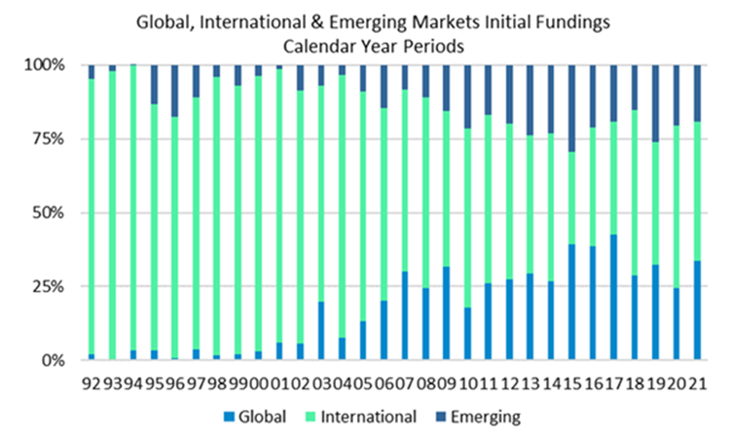
Emerging Markets Are Also Increasingly Used

Slide 14
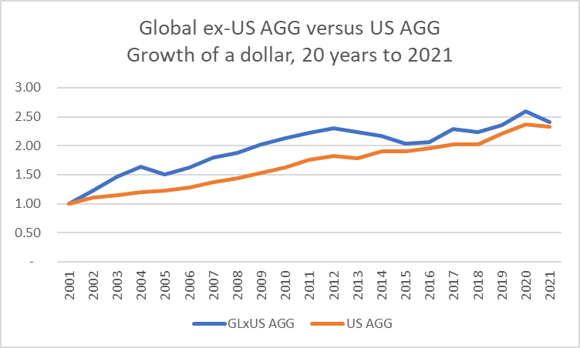
Bond Diversification
Currency can have a significant short-term impact on returns of US vs international bonds
Longer-term, this has tended to even out

Slide 15
Home Country Bias
There may be good reasons to favor the home country:
Large size of home market
Analytical decisions
Trading and liquidity constraints on non-domestic investing
Investor (or manager) does not have capability
These may all be rational (not bias), but often investors favor the home country significantly more than these reasons would suggest

Slide 16
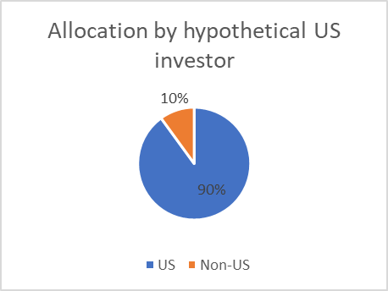
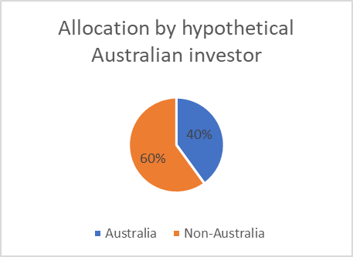
Home Country Bias Examples
US is close to two-thirds of world capitalization, so only a very high allocation would likely exhibit bias
Australia is just 2% of world capitalization, so a lower figure (e.g., 40%) would likely show bias

Slide 17
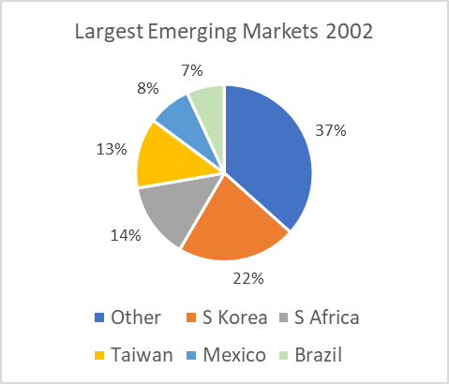
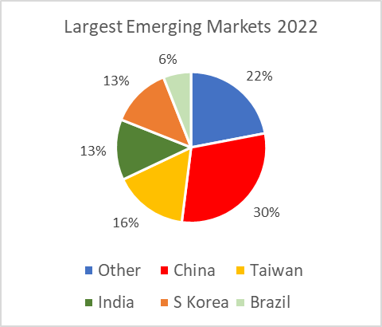
Emerging Markets
“Emerging Markets” as a term, was first used in 1980s, but acceptance grew slowly: 4% of ACWI by 2002
Now EM is over 10% of ACWI, and China is the largest EM

Slide 18
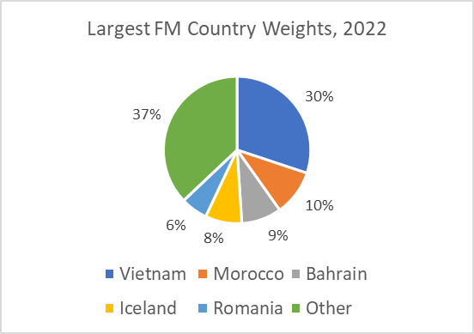
Frontier Markets (FM)
Lower tier of EM: markets are small individually and in aggregate
FM is about 1% of EM capitalization

Slide 19
Historical Returns: Emerging vs Developed Markets
There have been long cycles in relative performance of EM vs DM

Slide 20
Emerging Market Debt
EM debt includes both $-denominated and local currency
Local currency EM debt is dominated by Chinese issuers ($2.5tr, over 40% of the total local-currency EM debt market)
The $-denominated market is smaller ($2tr vs $6tr) and more geographically diverse

Slide 21
Investing in EM Debt
For a SMIF looking to invest in EM Debt, mutual funds or ETFs may be the most practical course
 | AUM ($bn) | Number of funds
Mutual funds | 57.1 | 71
ETFs | 27.9 | 24

Slide 22
Key Issues for International Investors
Global or International
Top-Down or Bottom-Up
Hedged or Unhedged
Active or Passive
Value vs Core vs Growth
Quantitative vs Fundamental
While the first three bullet points are less relevant for domestic investors, all of these issues require a thoughtful decision by SMIFs looking to invest internationally

Slide 23
Practical Issues for SMIFs
Globalize the process
Style and approach
Division of responsibilities
Finding information
Trading Platform and Instruments
Taxation
Accounting and Reporting

Slide 24
Accounting Standards, US vs International
US: GAAP
International: IFRS
Mandatory for US companies
Rules-based
Non-US companies listed in US must comply with GAAP
Increasingly used outside the US as the standard
Principles-based
Eventual goal is convergence between GAAP and IFRS but progress has been slow

Slide 25
Value Investing: “the lonely discipline”
“Graham and Dodd value investing can often be a lonely discipline, especially on the global level, where investors tend to herd to the “hot dot” countries or regions. Independence is part of the value investor’s DNA. In fact, the only way that long-term active value investing can outperform is by separating from the pack. Value investors operate differently; the truly focused ones are distinct from their peers, and their portfolios are often clearly miles away from their benchmark or index.” Charles Brandes, Value Investing Today
FOUR SUGGESTIONS for SMIFs ASPIRING TO BE SUCCESSFUL VALUE INVESTORS
WRITE EVERYTHING DOWN Document philosophy, process, decision rights, decision rationales; your SMIF successors will thank you
DO YOUR HOMEWORK Screening only gets you so far; you need to do the detailed analysis
BROADEN YOUR HORIZONS Think global in geography, and long-term in time-frame
UNDERSTAND YOUR BIGGEST ENEMY MAY BE YOURSELF Successful value investing is a mental discipline

Slide 26
Key Points
Investing internationally provides opportunity, diversification and a global perspective for both equities and bonds
It also introduces more complications: information needs and analysis, organization and process, trading and operational issues
Results have been variable, and for US-based investors, international has lagged domestic for the decade through 2021
SMIFs should consider carefully the opportunity relative to costs and risks: deciding to invest globally requires commitment to a long-term decision

